Slide 1
DS-306 Data Warehousing and Business Intelligence
Topic 3: Conceptual Data Warehouse Design
Dr. Khurram Shahzad

Slide 2
Dimensional Model Summary

Slide 3
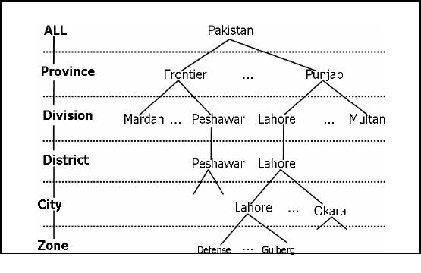
Inside Dimension
  Primary key of the dimension table uniquely identifies each row in the table
  Textual attributes: In dimension table you will seldom find any numerical values used for calculations

Slide 4
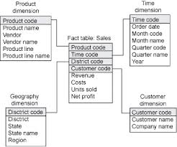
Inside Dimension

Slide 5
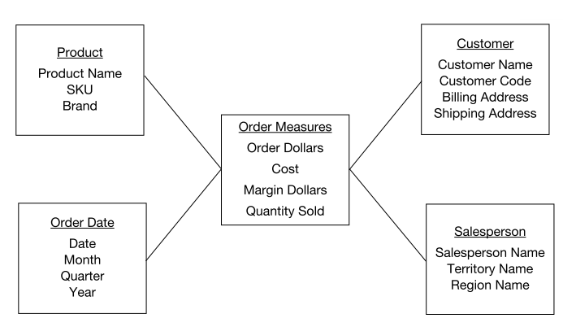
Example
Intuitively answer the question of what, when, by whom and to whom
  For a given product sold?
  Who was the customer?
  Which sales person brought the order?
  When was the order placed?

Slide 6
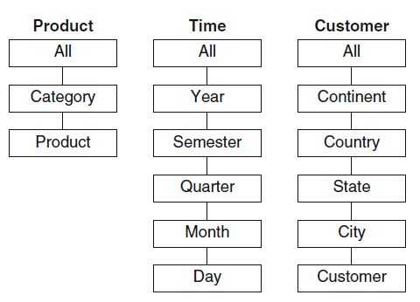
Hierarchies
Hierarchies represent the measures under analysis at different abstraction levels

Slide 7
Inside Dimensional Modeling
Inside Dimension table
  Key attribute of dimension table, for identification
  Large number of columns, wide table
  Non-calculated attributes, textual attributes
  Attributes are not directly related
  Un-normalized in Star schema
  Normalized in Snowflake schema
  Can have multiple hierarchies
  Relatively small number of records

Slide 8
Inside Dimensional Modeling
  Have two types of attributes
    Key attributes, for connections
    Non key attributes
Inside fact table
  Composite key
  Grain or level of data identified
  Large number of records
  Limited attributes (decision makers are interested in small number of facts)

Slide 9
Star Schema Keys
Easy to understand
Optimized for navigation
  To go from one table to another
  For obtaining relative value of dimension
Most suitable for query processing

Slide 10
Star Schema Keys
Primary keys (in dimension)
  Identifying attribute in dimension table
  Relationship attributes combine together to form P.K
Surrogate keys (in dimension)
  Replacement of primary key
  System generated
Foreign keys (in fact, dimension)
  Collection of primary keys of dimension tables
Primary key to fact table
  Collection of P.Ks

Slide 11
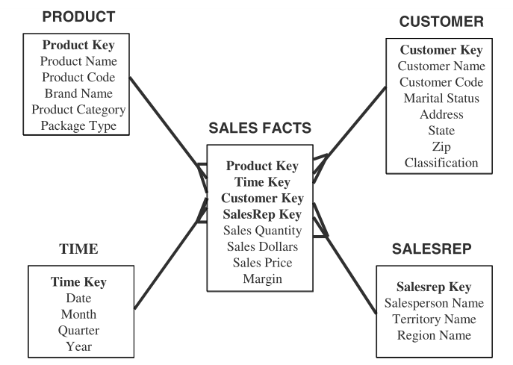
From Star to Snowflake Schema
Product dimension

Slide 12
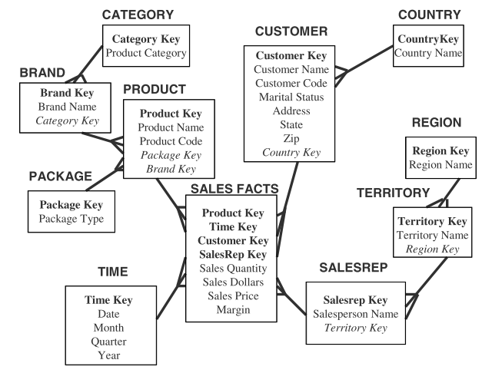
From Star to Snowflake Schema
Product dimension

Slide 13
Conceptual vs Logical Design
Concepts are mapped to tables

Slide 14
Relational DW Design
Relational representation of multidimensional model is Star-oriented Schema
  One central Fact table
  A set of dimension tables
Fact table contains foreign keys of related dimension tables
Referential integrity constraints are specified between dimension and fact table

Slide 15
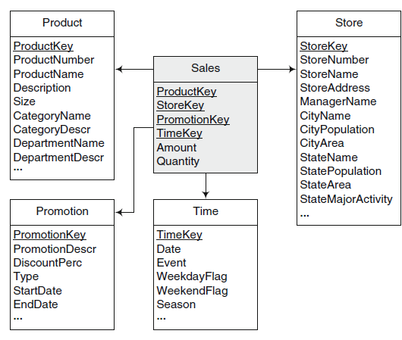
Example Star Schema

Slide 16
Types of Logical Schemas
Star Schema
Snowflake Schema
Starflake Schema
Constellation Schema

Slide 17
Start Schema
Dimension tables are not normalized
Therefore, they may contain redundant data
Especially, in the presence of hierarchies

Slide 18
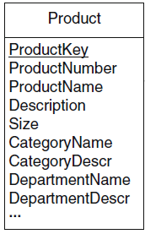
Start Schema
Example: Product Dimension
  All products belonging to the same category
  So, all the category information will be redundant

Slide 19
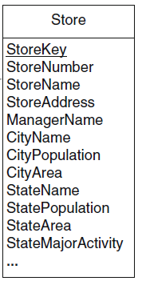
Start Schema
Example: Store Dimension
  All stores (unique) belong to the same city
    So, all the category information will be redundant
  All stores (unique) belongs to the same state
    So, all the state information will be redundant

Slide 20
Snowflake Schema
Snowflake avoids the redundancy of start schemas by normalizing the dimension tables
Therefore, a dimension is represented by several tables related by referential integrity
Referential integrity constraints is also between fact table and the dimension tables at the fines level of details

Slide 21
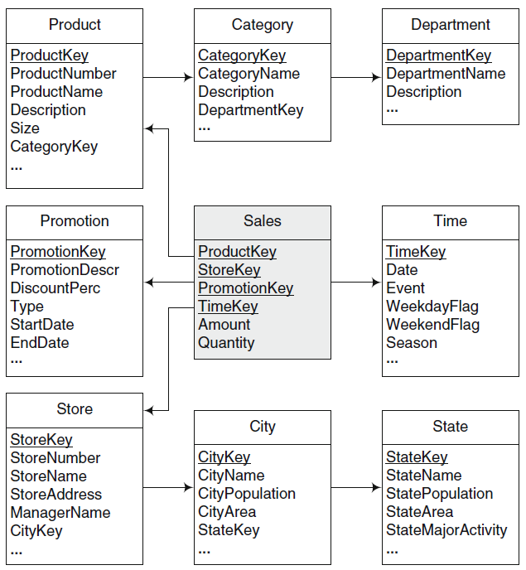
Example
Snowflake

Slide 22
Starflake Schema
A combination of star and snowflake.
Some dimensions are normalized while others are not
Constellation Schema
Schema has multiple fact tables that share dimension tables

Slide 23
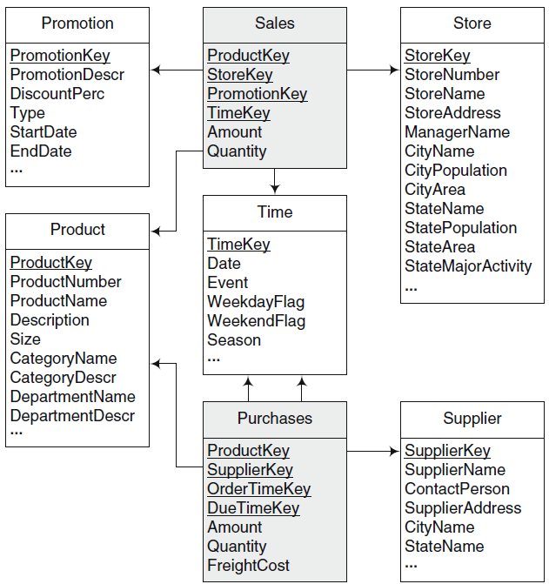
Constellation Schema Example

Slide 24
Summary of Schema Types
Snowflake schema
  Can be achieved by apply normal form on dimensions
  Advantages
    Decreased storage
    Normalized structures are easily updated
  Disadvantages
    Users are put-off to complexity
    Query performance is decreased due to join
Star-flake
  Some dimensions are normalized and some are not
Constellation schema
  Many star schemas

Slide 25
Conceptual to Logical

Slide 26
Relational Implementation
Set of rules are applied to translate conceptual model (MultiDim model) to relational model

Slide 27
Rule 1
A level L, provided that it is not related to a fact with one-to-one relationship, is mapped to table TL that contains all attributes of the level
A surrogate key may be added
Or, the identifier of the level will be the key of the table

Slide 28
Rule 2
A fact F is mapped to a table TF that includes as attributes all measures of the fact
Further, a surrogate key may be added to the table

Slide 29
Rule 3
A relationship between either a fact F and a dimension level L, or between dimension level LP and LC (parent child) can be mapped in three different ways
  One-to-one relation
  One-to-many relation
  Many-to many

Slide 30
Rule 3a
Rule 3a: If the relationship is one-to-one, the table corresponding to the fact TF or the child TC is extended with all the attributes of dimension level or the parent level

Slide 31
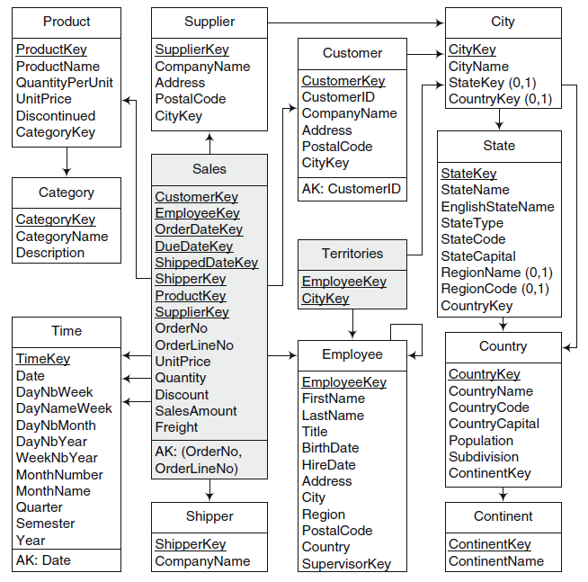
OrderNo
OrderlineNo
are dimensions but
included in fact table

Slide 32
Rule 3b
Rule 3b: If the relationship is one-to-many, the table corresponding to the fact TF is extended with the surrogate key of the table corresponding to the dimension level TL
That is, a foreign key in the fact or child table pointing to the other table

Slide 33
Product, Supplier
Have 1:M relationship

Slide 34
Rule 3c
Rule 3c: If the relationship is many-to-many, a new table TB (bridge table) is created that contains as attributes the surrogate keys to the corresponding to the fact TF and the dimension level TL, or the parent TP and child level TC
The key of the table is the combination of both surrogate keys

Slide 35
Many-to-Many Relationship
Many-to-many relationship parent-child relationship between Employee and territory is mapped to the table territories containing two foreign keys

Slide 36
Employee, Territory
have M:M relation
New table is added

Slide 37
Two possibilities of keys
There are two possibilities of defining the keys of dimension levels
  Generating Surrogate keys
  Keeping DB key as DW key

Slide 38
Surrogate key is
added to Customer

Slide 39
Implications of rules
In all rules, surrogate keys are generated for each dimension level
Reasons: Provide independence from keys of the underlying sources
That is, underlying keys can change across time
Also, Surrogate keys are integers that increases efficiency compared to strings

Slide 40
Time Dimension
DW is historical DB. So, time dimension is present in every DW
Time information is included both as foreign keys in a fact table
Contains aggregation level in which facts can be aggregated across time
This information is defined from DATE

Slide 41
Logical representation of hierarchies

Slide 42
Balanced Hierarchies
Recall,
  A balanced hierarchy has only one path where al the levels are mandatory
  All the branches have the same length
Levels of dimension hierarchies are represented indepdentently
Are linked by parent-child relationships
Snowflake schema

Slide 43
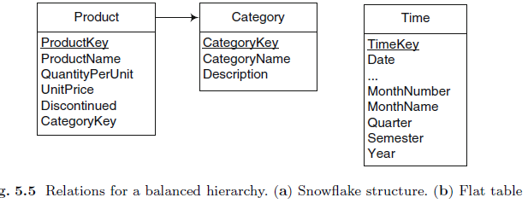
Balanced Hierarchies
Example snowflake structure on left
Flat table on right (denormalized table)
  May contain several levels

Slide 44
Unbalanced hierarchies
A combination of star and snowflake.
Some dimensions are normalized while others are not

Slide 45
Starflake Schema
A combination of star and snowflake.
Some dimensions are normalized while others are not

Slide 46
Starflake Schema
A combination of star and snowflake.
Some dimensions are normalized while others are not

Slide 47
Starflake Schema
A combination of star and snowflake.
Some dimensions are normalized while others are not

Slide 48
Starflake Schema
A combination of star and snowflake.
Some dimensions are normalized while others are not

Slide 49
Starflake Schema
A combination of star and snowflake.
Some dimensions are normalized while others are not

Slide 50
Starflake Schema
A combination of star and snowflake.
Some dimensions are normalized while others are not

Slide 51
Starflake Schema
A combination of star and snowflake.
Some dimensions are normalized while others are not

Slide 52
Starflake Schema
A combination of star and snowflake.
Some dimensions are normalized while others are not

Slide 53
Starflake Schema
A combination of star and snowflake.
Some dimensions are normalized while others are not

Slide 54
Starflake Schema
A combination of star and snowflake.
Some dimensions are normalized while others are not

Slide 55
Starflake Schema
A combination of star and snowflake.
Some dimensions are normalized while others are not

Slide 56
Starflake Schema
A combination of star and snowflake.
Some dimensions are normalized while others are not

Slide 57
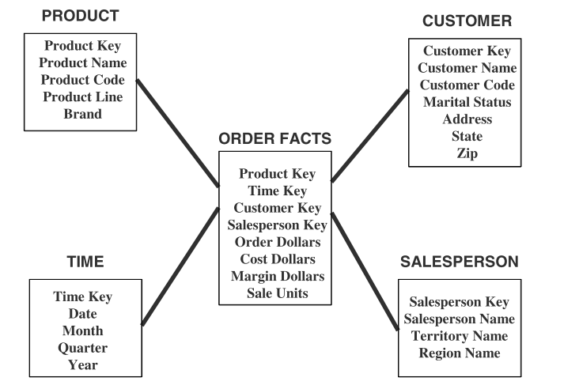
Updates to dimension table
Facts: sales units
More data is added every time
Consider dimension table,
In product dimension table, new rows are added
What about changes in attributes, When a product is moved to a different category
Consider the example of customer. What happens if the customer demographics are changed

Slide 58
Updates to dimension table
Dimension tables are more stable and less volatile
Example (if product category is changed)
Slowly changing dimensions (principles are)
  Most dimensions are generally constant over time
  Many dimensions, though not constant over-time, change slowly
  Product key does not change
  Overwriting data in dimension tables is not a good option always
Types of changes that affect dimension tables, & way of dealing with these types

Slide 59
Types of Changes
Type 1 Changes: Correction of errors
Type 2 Changes: History preservation
Type 3 Changes: Tentative revisions

Slide 60
Types 1 changes: Correction of errors
For example, spelling of customer name is changed from Hammad Akram to Hammad Ikram
OR Kristian Daniel to Kristian Fasel due to change in martial status
  No need to preserve old value of Hammad “Akram”
  But change in martial status is slightly different
  If it is not a correction in data, different results will be generated when user analyze the same result

Slide 61
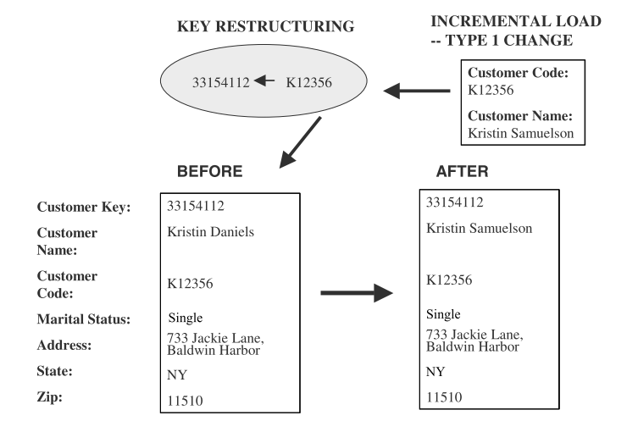
Types 1 changes: Correction of Errors
Changes to DW
  Solution, over-write old values with new values
  Old value is not preserved
  Key is not affected
  Easiest to implement

Slide 62
Type 2 changes: Preservation of History
Assume that in DW an essential requirement is to track orders by marital status
  If change happed on 1 Oct 2000 all order before that should be included in martial status single.
  Similarly orders after that under marital status married
  Assume city is also change from Lhr to Isl so both changes must be saved
Principles:
  Relate to true change in source systems
  There is a need to preserve history in DW

Slide 63
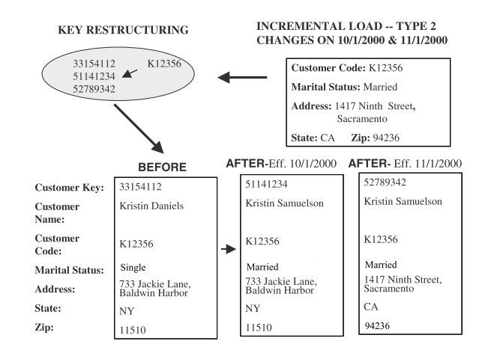
Type 2 changes: Preservation of History
Applying type 2 changes in DW
  There are no change to the original row in dimension table
  Add a new dimension table row
  The key of the original row is not affected
  The new row is inserted with a new surrogate key

Slide 64
Type 3 changes: Tentative Soft Revisions
We apply type 2 change to a certain date (the date is a cut off point)
  What if you need to count the orders on or after the cut-off date in both groups? This cannot be handled with type 2
  i.e. sometimes there is a need to track both old and new values for a certain period
  For instance realigning territories

Slide 65
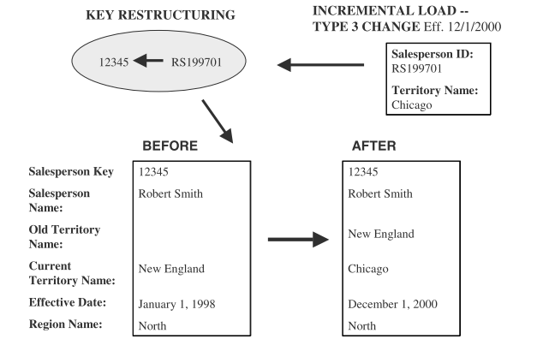
Type 3 changes: Tentative Soft Revisions
Solution
Add a new field in the dimension table
  Push down the existing values from current to old
  Keep the new values of the attribute in the “current” field

Slide 66
Summary of Types of changes
Change1. Correction of errors
  Problem, Name of a person is changed, to correct error
  Solution, over-write old value
  Old value is not saved
  Key is not affected, Easiest to implement
Change 2. History preservation
  Problem, Name is changed, marital status & address
  Solution, Inserting new row for each change
  Change has certain affect on analysis
  Key is not affected, new surrogate key
Change 3. Tentative revisions
  Problem, Old address of customer is not known
  Solution, Insert another attribute, with date
  New row is not needed

Slide 67
Large & Rapid Dimensions
A dimension is considered large based on two factors
  A large dimension is deep i.e. large no of rows
  A large dimension is wide i.e. large no of columns
In our case customer and product dimension may be gigantic
Multiple hierarchies
  Large dimensions tend to have multiple hierarchies

Slide 68
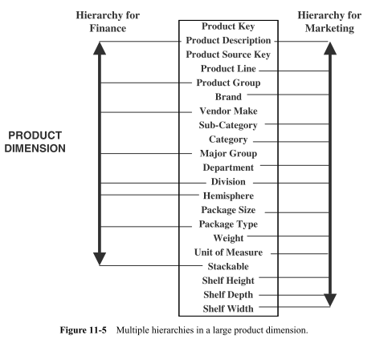
Large & Rapid Dimensions

Slide 69
Rapidly changing dimensions
Earlier, we had assumed dimension attributes do not change rapidly
For type 1 change, a new row is created with new attribute value
What if the change occurs too many times?
This dimension is no longer a slowly changing dimension
Particularly, in Large dim. frequent changes cannot be handled with any type of change, the reasons are
  Change1, Old value can be old
  Change2, count of tupples can be increased
  Change3, Not possible to add so many attributes

Slide 70
Rapidly changing dimensions
A product dimension may not change very frequently in a year
But consider a large customer dimension, where millions of customers may exist
  But significant attributes in a customer dimension may change many times in a year (rapidly changing dimension)
In the case if dimension table is too large and changing too rapidly
Break down dimension table into two parts

Slide 71
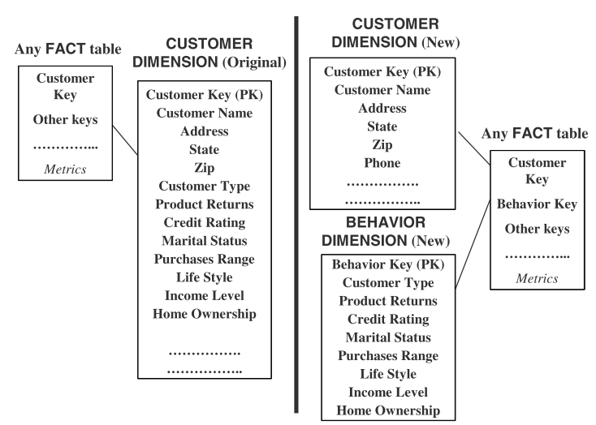
Rapidly changing dimensions
Leads to
Snow flake

Slide 72
Summarizability of measures
Summarizability refers to the correct aggregation of cube measures along dimension hierarchies
Conditions to ensure summarizability
  Disjointness of instances
    The grouping of instances in a level with respect to their parent is the next level must results in disjoint subsets
  Completeness
    Must be included ni hierarchy and each instance must be related to one parent in the next level

Slide 73
Summarizability of measures
Conditions to ensure summarizability
  Disjointness of instances
  Completeness
  Correctness
    Correct use of the aggregation functions

Slide 74
Types of Measures
Additive measure
  Meaningfully summarized along all the dimension, using addition e.g. quantity
Semiadditive measures
  Can be meanfully summarized using addition along some, but not all, dimensions e.g. inventory quantity
Nonadditive measures
  That cannot be meaningfully summarized using addition across dimensions e.g. price, cost per unit, exchange rate

Slide 75
OLAP

Slide 76
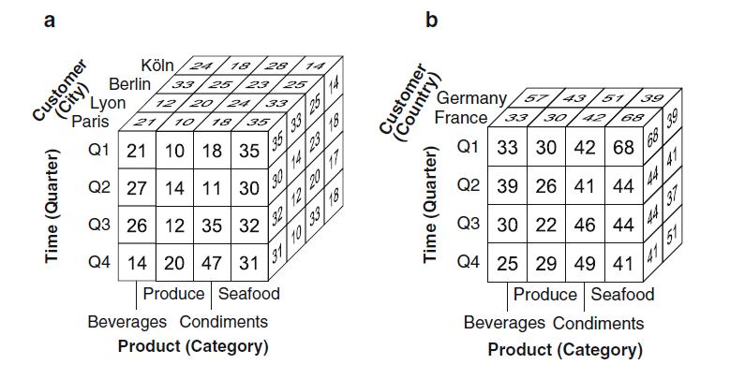

OLAP Operations

Slide 77
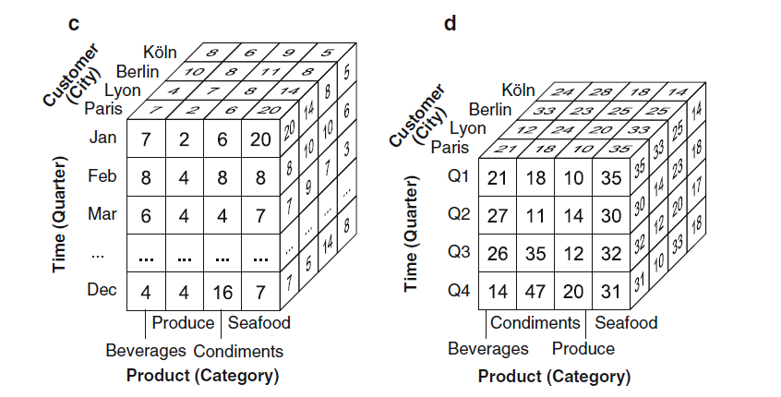
OLAP Operations

Slide 78
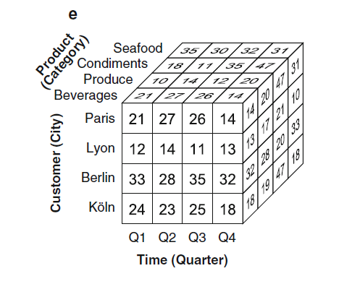
OLAP Operations

Slide 79
OLAP Operations
Rollup
    Aggregates measures along a dimension hierarchy to obtain measures at a coarser granularity
Drill-down
    It goes from a more general level to a more detailed level in a hierarchy
Slice
    Removes a dimension in a cube (n-1 dimensions)
Dice
  Keeps the cells in a cube that satisfy a boolean condition

Slide 80
Business Intelligence Tools

Slide 81
Conceptual DW Design

Slide 82
Star Schema Keys
Primary keys (in dimension)
  Identifying attribute in dimension table
  Relationship attributes combine together to form P.K
Surrogate keys (in dimension)
  Replacement of primary key
  System generated
Foreign keys (in fact, dimension)
  Collection of primary keys of dimension tables
Primary key to fact table
  Collection of P.Ks

